Slide 1
Digital Communication
EED 350 (Spring 2020)
Final Project Presentation
Harshvardhan Singh (1710110139)
Moesha Malik(1710110216)

Slide 2
MAP Detection of Misbehaving Relay in Wireless Multiple Access Relay Networks
Introduction
Network coding is a new relaying technique that replaces the traditional store and forward paradigm of network routing by a method that allows intermediate (relay) nodes to mix the received data before re-transmission.
This has been shown to maximize throughput, as well as robustness. While network coding can be an efficient means of information dissemination in networks, it also presents a new security challenge as a single corrupted packet has the potential to corrupt every packet received by a given destination.
The problem of detecting misbehaving relays that inject false data in single-source networks has been studied in. The receiver then computes the ground truth of the tracing bits and compares them with the tracing bits received from a relay to determine whether it is malicious or cooperative. All these major previous works, however, require sending extra reference data (overhead) at the source to detect the misbehaving relay

Slide 3
Previous Works
The problem of detecting misbehaving relays that inject false data in single-source networks has been studied in the papers referred to below:
In (“Signatures for content distribution with network coding, in Proc. IEEE International Symposium on Information Theory, June 2007) the authors consider a peer-to-peer (P2P) network in which the source generates a signature vector and broadcasts to all nodes where it is used to check the integrity of the received packets.
In (“Byzantine modification detection in multicast networks with random network coding, IEEE Trans. Inf. Theory, vol. 54, no. 6, pp. 2798-2803, June 2008 and “Resilient network coding in the presence of Byzantine adversaries, IEEE Trans. Inf. Theory, vol. 54, no. 6, pp. 2596-2603, June 2008.) several Information Theory based algorithms are proposed for mitigating Byzantine modification attack.
In (“Tracing malicious relays in cooperative wireless communications, IEEE Trans. Inf. Forensics Security, vol. 2, no. 2, pp. 198-212, June 2007) the authors consider inserting tracing bits in the data stream at the source in a cryptographically secure manner. The receiver then computes the ground truth of the tracing bits and compares them with the tracing bits received from a relay to determine whether it is malicious or cooperative.
Extensions to multiple-source networks have been studied in (“Error analysis in multi-source, multi-relay, multi-destination networks under falsified data injection attacks,” in Proc. IEEE MILCOM, 2008 and “An algebraic watchdog for wireless network coding, in Proc. IEEE International Symposium on Information Theory, June 2009), where the tracing bits or polynomial hash functions are used in detecting the misbehaving relays.

Slide 4
Literature Review from Reference Papers (1/2)
Signatures for content distribution with network coding, in Proc. IEEE International Symposium on Information Theory, June 2007
This paper proposes a new signature scheme that is based on and is designed specifically for random linear coded systems. In this scheme, we view all blocks of the file as vectors, as in any network coding scheme, and make use of the fact that all valid vectors transmitted in the network should belong to the subspace spanned by the original set of vectors from the file. We design a signature that can be used to easily check the membership of a received vector in the given subspace, and at the same time, it is hard for a node to generate a vector that is not in that subspace but passes the signature test. We show that this signature scheme is secure, and that the overhead for the scheme is negligible for large files.
The signature scheme makes use of the linearity property of random linear network coding, and enables the peers to check the integrity of packets without the requirement for a secure channel, as in the case of hash function or Secure Random Checksum (SRC) schemes .Also, the computation involved in the signature generation and verification processes is very simple.

Slide 5
Literature Review from Reference Papers (2/2)
Byzantine modification detection in multicast networks with random network coding, IEEE Trans. Inf. Theory
Byzantine modification detection capability can be added to a multicast scheme based on random linear block network coding, with modest additional computational and communication overhead, by incorporating a simple polynomial hash / check value in each packet.
With this approach, a sink node can detect Byzantine modifications with high probability, as long as these modifications have not been designed with knowledge of the random coding combinations present in all other packets obtained at the sink: the only essential condition is the adversary's incomplete knowledge of the random network code seen by the sink. No other assumptions are made regarding the topology of the network or the adversary's power to corrupt or inject packets.

Slide 6
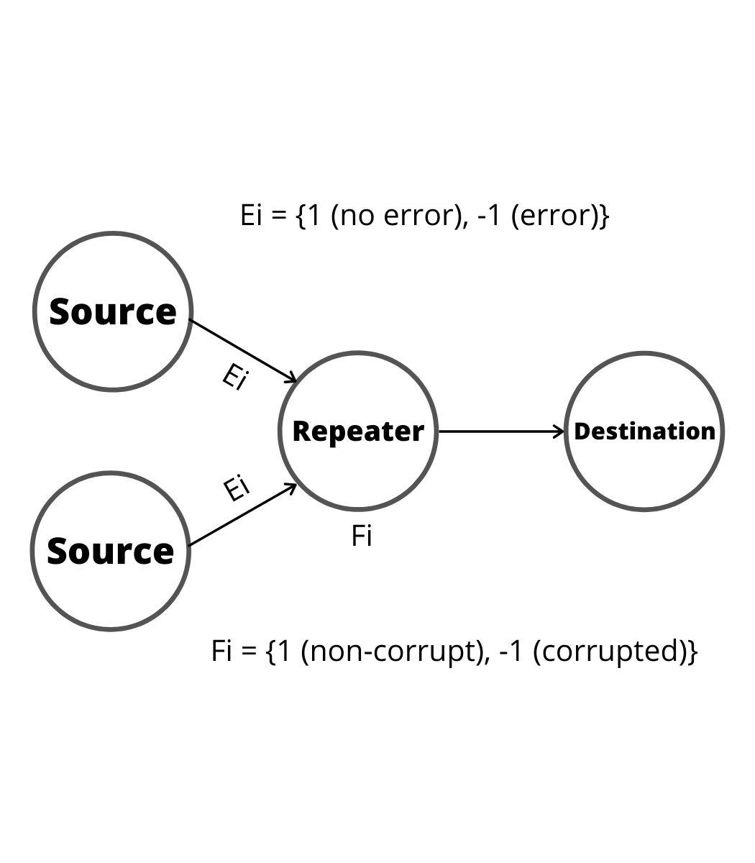
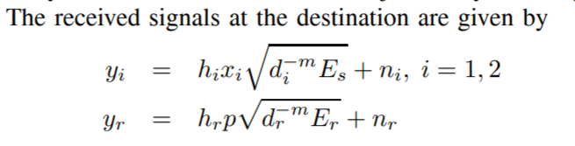
Project Proposal
The paper proposes the maximum a posteriori (MAP) approach in detecting the misbehaving relay that may inject false data or add chan
The MAP detection scheme is based on the log-likelihood ratio (LLR) test which is optimal in the sense of minimizing the probability of incorrect decisions (false alarm and misdetection).
The proposed scheme does not require sending extra bits at the source, such as hash function or message authentication check bits, and hence there is no transmission overhead. In addition, it makes an instantaneous decision about whether a relay is behaving properly without a long term observation. We derive the probability of false alarm and misdetection as a function of the signal-to-noise ratio, taking into account the lossy nature of wireless links. The side information regarding the presence of relay misbehavior is exploited at the destination (decoder) to mitigate the relay misbehavior and enhance the reliability of decoding.
The MAP decoding scheme exploits the likelihood of the presence of relay misbehavior, and show that it provides a dramatic improvement over the conventional decoder that does not exploit the side information.

Slide 7
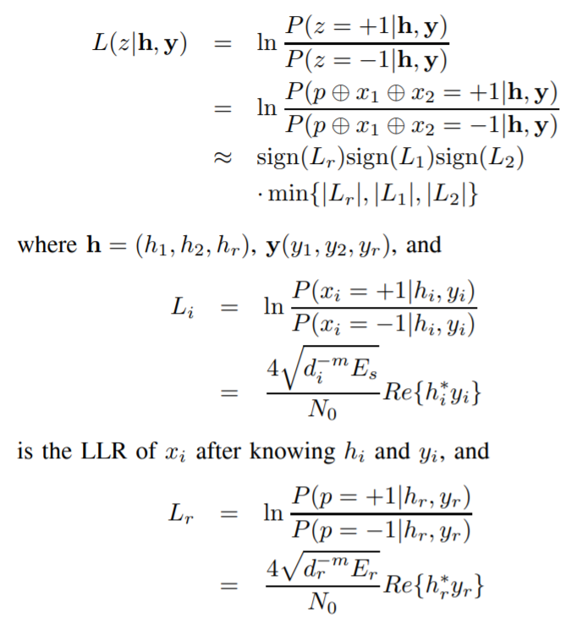
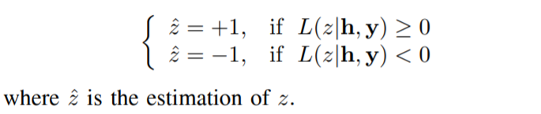
MAP Detection Scheme
The destination is interested in finding whether 𝑧 is +1 (well-behaving) or −1 (misbehaving) and exploiting the information regarding 𝑧 in decoding. The MAP detection rule which minimizes the probability of incorrect decisions is based on the LLR of 𝑧 as shown on the right:
The MAP detection rule s then given by:

Slide 8
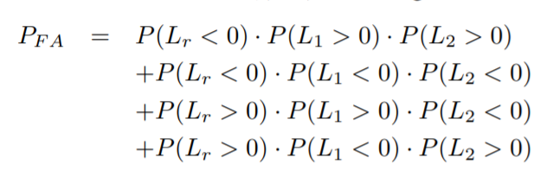
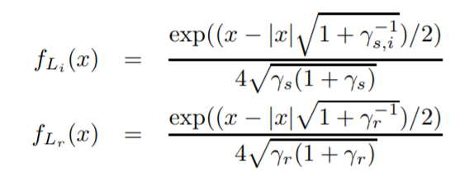
Probability of False Alarm and Detection
Since the equation we covered before for 𝐿(𝑧∣h, y)indicates that the sign of 𝐿(𝑧∣h, y) becomes negative if one or three of the LLRs 𝐿𝑟, 𝐿1, 𝐿2 are negative, we obtain:
We also derive the probability of false alarm and misdetection.
The false alarm is the event that the destination decides 𝑧ˆ = −1 given 𝑧 = 1, i.e. 𝑝 = 𝑥1 ⊕ 𝑥2, while the misdetection is the event that the destination decides 𝑧ˆ = 1 given 𝑧 = −1, i.e. 𝑝 = 𝑥1 ⊕ 𝑥2 ⊕ (−1).
𝑃𝐹 𝐴 = 𝑃(𝐿(𝑧∣h, y, 𝑝 = 𝑥1 ⊕ 𝑥2) < 0)
where we assumed that the elements in h and y are independent, hence so are 𝐿𝑟, 𝐿1, 𝐿2. Applying the probability density function (pdf) of 𝐿𝑖, 𝐿r

Slide 9
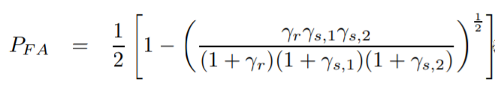
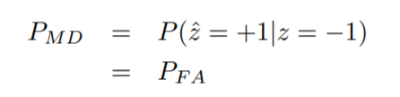
Probability of False Alarm and Detection (contd..)
Substituting pdf distributions of L_{r} and L_{i} into P_{FA} equations, we get:
where 𝛾_{𝑠,𝑖} = 𝑑^{−𝛼} _{𝑖} 𝐸_{𝑠}/𝑁₀ and 𝛾_{𝑟} = 𝑑^{−𝛼} _{𝑟} 𝐸_{𝑟}/𝑁₀ are the received symbol SNR at the destination from the 𝑖-th source and relay, respectively
Similarly, it can be shown that the probability of misdetection is given by

Slide 10
Decoding Schemes
MAP Decoder
The MAP decoder calculates the LLR given the channel fading gain, h and received signal, y and decide 𝑥^1 = +1 if 𝐿(𝑥1∣h, y) > 0 and 𝑥^1 = −1 otherwise. The MAP decoder requires the side information 𝐿(𝑧∣h, y) which represents the likelihood of the presence of relay misbehavior.
Genie-aided Decoder
The genie-aided decoder assumes perfect information regarding 𝑧, and chooses the most probable codeword from the set of transmitted codewords. Although the genie-aided decoding may not be realistic, it may serve as a reference for performance comparison with other decoders.
Conventional Decoder
The conventional decoder does not utilize the side information regarding 𝑧. Hence, the decoder considers (𝑥1, 𝑥2, 𝑝𝑡), where 𝑝𝑡 = 𝑥1 ⊕ 𝑥2, as a valid codeword no matter what 𝑧 is. Therefore, if 𝑧 = −1, the conventional decoder considers (𝑥1, 𝑥2, 𝑝𝑡) as a valid codeword while (𝑥1, 𝑥2,−𝑝𝑡) is valid.If 𝑧 = 1, it considers (𝑥1, 𝑥2, 𝑝𝑡) as a valid codeword while (𝑥1, 𝑥2, 𝑝𝑡) is valid.

Slide 11
IMPLEMENTATION

Slide 12
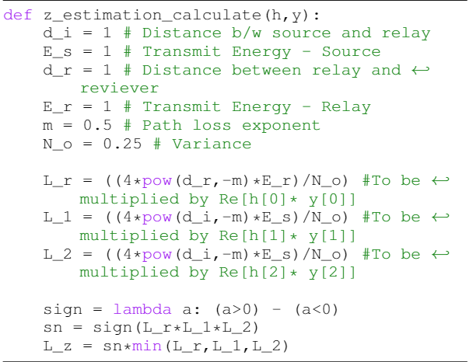
MAP Detection Scheme

Slide 13
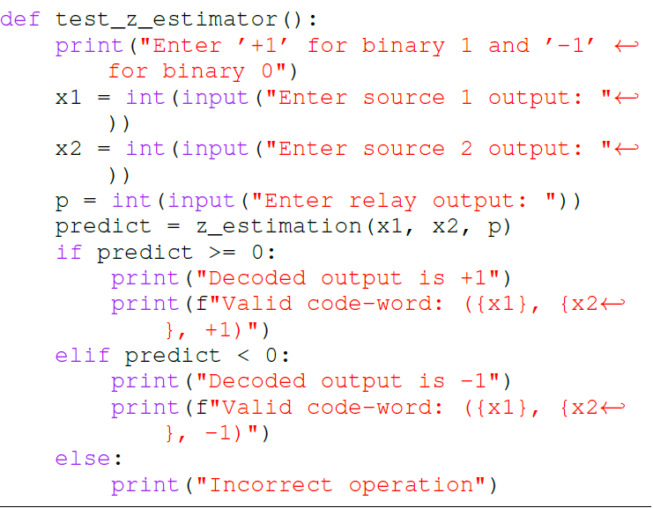
MAP Decoder

Slide 14
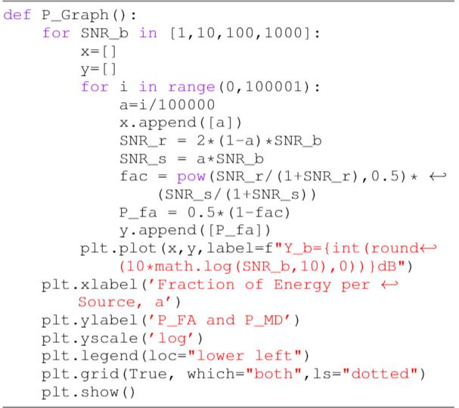
Probability of False Alarm and Detection

Slide 15
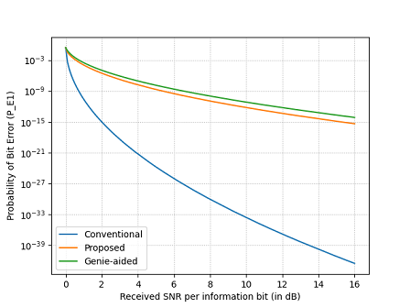
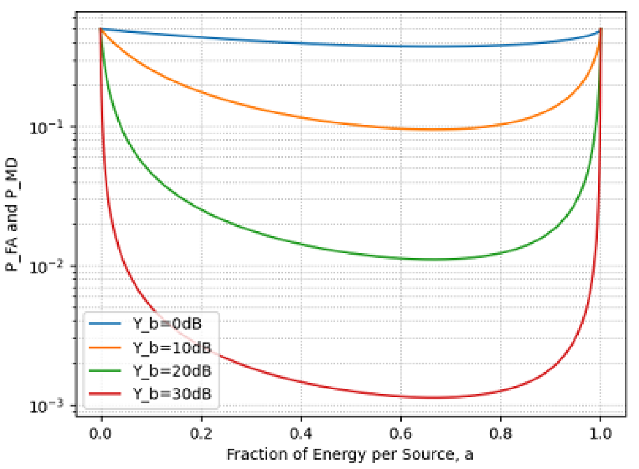
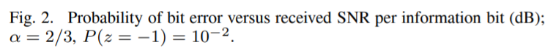
Results
Fig 3. Probability of false alarm and mis-detection v/s fraction of energy per source

Slide 16
Conclusion
Numerical Results and Discussion
The first figure (in the last slide) shows the probability of false alarm 𝑃_{𝐹𝐴} and misdetection 𝑃_{𝑀𝐷} versus the fraction of energy allocated to each source, 𝛼 = 𝛾_{𝑠}/𝛾_{𝑏}, where 𝛾_{𝑏} = (2𝛾_{𝑠} + 𝛾_{𝑟})/2 is the received SNR per information bit. The paper proposes that the optimum 𝛼 that minimizes 𝑃_{𝐹𝐴} and 𝑃_{𝑀𝐷} is 2/3. In general, for 𝐾 sources and 𝑅 relays, the optimum 𝛼 claimed to be 𝐾/(𝐾 + √𝑅)
The second figure, shows the probability of bit error versus the received SNR per information bit, 𝛾_{𝑏}. We notice that the MAP decoder that exploits the side information 𝐿(𝑧∣h, y) provides a dramatic improvement over the conventional decoder that does not exploit the side information and that the probability of bit error for the latter exhibits an error floor. This shows that it is crucial to exploit the side information regarding the presence of relay misbehavior at the decoder to effectively mitigate the relay misbehavior.
The proposed MAP approach in detecting the misbehaving relay that injects false data or adds channel errors into the network encoder in multi-access relay networks, does not require sending extra bits at the source, and therefore, there is no transmission overhead.
In addition, it is optimal in the sense of minimizing the probability of false alarm and misdetection. We derived the probability of false alarm and misdetection, taking into account the lossy nature of wireless links.
We also presented the MAP decoding scheme that exploits the side information regarding the presence of relay misbehavior and showed that it can effectively mitigate the relay misbehavior.

